Slide 1
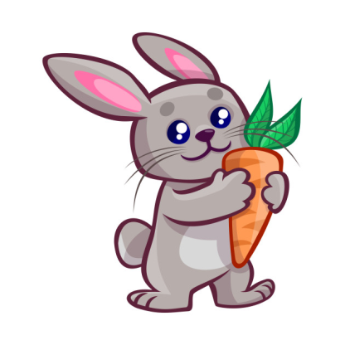
There are eleven rabbits.

Slide 2
There are twelve rabbits.

Slide 3
There are thirteen rabbits.

Slide 4
There are fourteen rabbits.

Slide 5
There are fifteen rabbits.

Slide 6
There are sixteen rabbits.

Slide 7
There are seventeen rabbits.

Slide 8
There are eighteen rabbits.

Slide 9
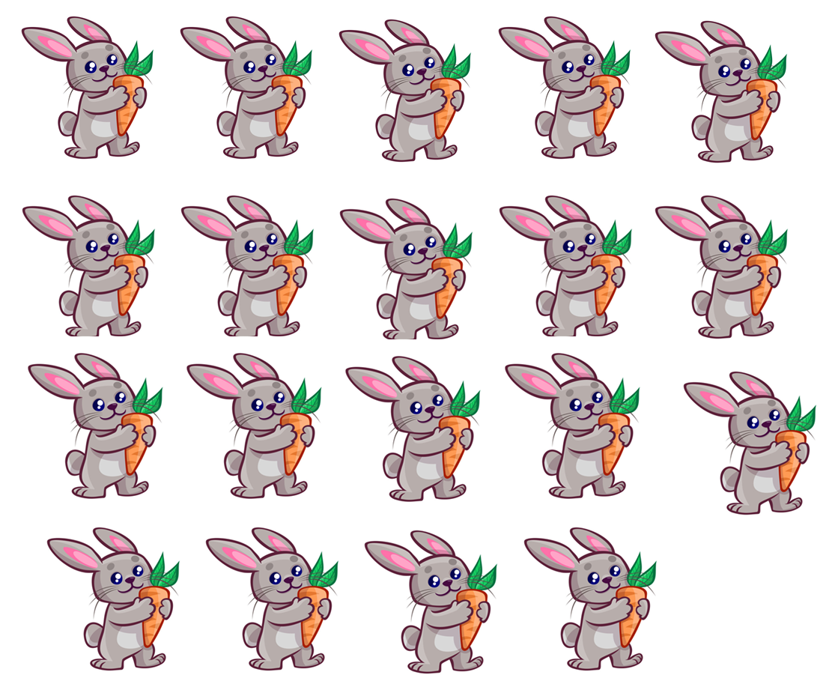
There are nineteen rabbits.

Slide 10
There are twenty rabbits.

